Slide 1
Xoxoday Social Media Analytics Capstone
Social Network Analysis (SNA) for Customer Acquisition & Engagement
BANL 6900 | University of New Haven | December 2025
Prepared By: Your Name

Slide 2
Research Question
How can Xoxoday leverage Social Network Analysis (SNA) to:
1. Identify key influencers amplifying brand content?
2. Detect communities and engagement clusters?
3. Optimize content, posting schedules & partnerships to boost reach and conversions?
Goal: Improve engagement and customer acquisition using data-driven insights.

Slide 3
Business Challenges
Problem 1: Low Organic Reach – Xoxoday tweets do not spread widely.
Problem 2: Weak Influencer Engagement – Key amplifiers not being targeted.
Problem 3: Limited Community Penetration – Engagement clusters not activated.
Outcome: Brand messaging limited to small circles of repeat users & partners.

Slide 4
Dataset Overview
Dataset: W19310-XLS-ENG.xlsx
• Tweets Data (Xoxoday posts)
• Retweets Data (interaction edges)
• User Info Data (vertex-level attributes)
Time Range: January 17–30, 2017
Methods Used: R, Python, NodeXL, SNA Metrics
Final Graph: Directed retweet/reply network

Slide 5
Methods used
A) Graph Construction:
• Builds a directed graph representing retweets and replies.
• Captures information flow between users.
B) Cluster Analysis:
• Uses modularity-based community detection.
• Identifies natural engagement clusters.
C) Outcome:
• Reveals influencers, content drivers, engagement paths.
• Supports improvements: influencer partnerships, posting schedule optimization, content enhancement.

Slide 6
Key Findings
• Engagement centered around a small cluster of loyal users.
• Xoxoday account is NOT the central hub → weak reach.
• Three major communities detected.
• Visual + hashtag posts outperform text-only tweets. Nodes: unique user_ids (screen_name, user_id)
Edges: (from -> to) for retweets, replies, mentions; weight = count
Directed graph captures flow of information and influence Data Summary Tweets rows: 4565
Retweet edges: 467
Unique users/nodes: 90

Slide 7
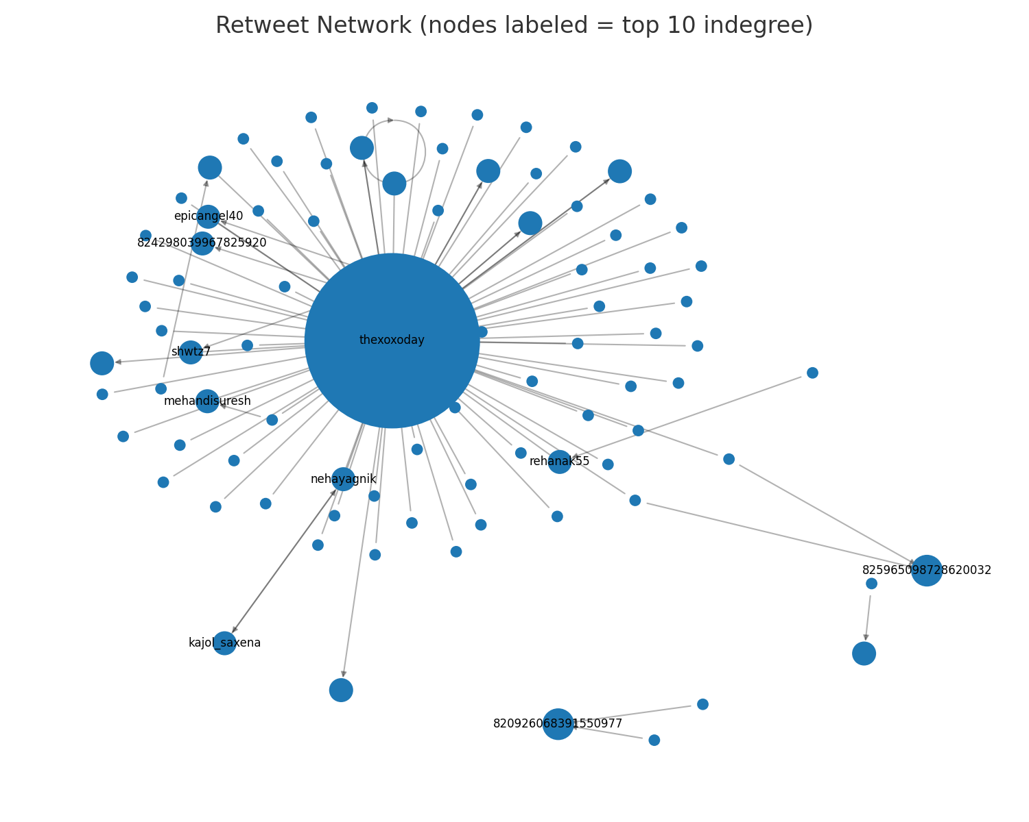
Retweet Network Graph
The chart 'Retweet Network Graph' shows key structural network insights:
• Helps identify how engagement flows
• Indicates influencers, connectors, or cluster hubs
• Supports strategic targeting and posting adjustments Shows the entire retweet network. Xoxoday is not a central hub → weak message spread.

Slide 8
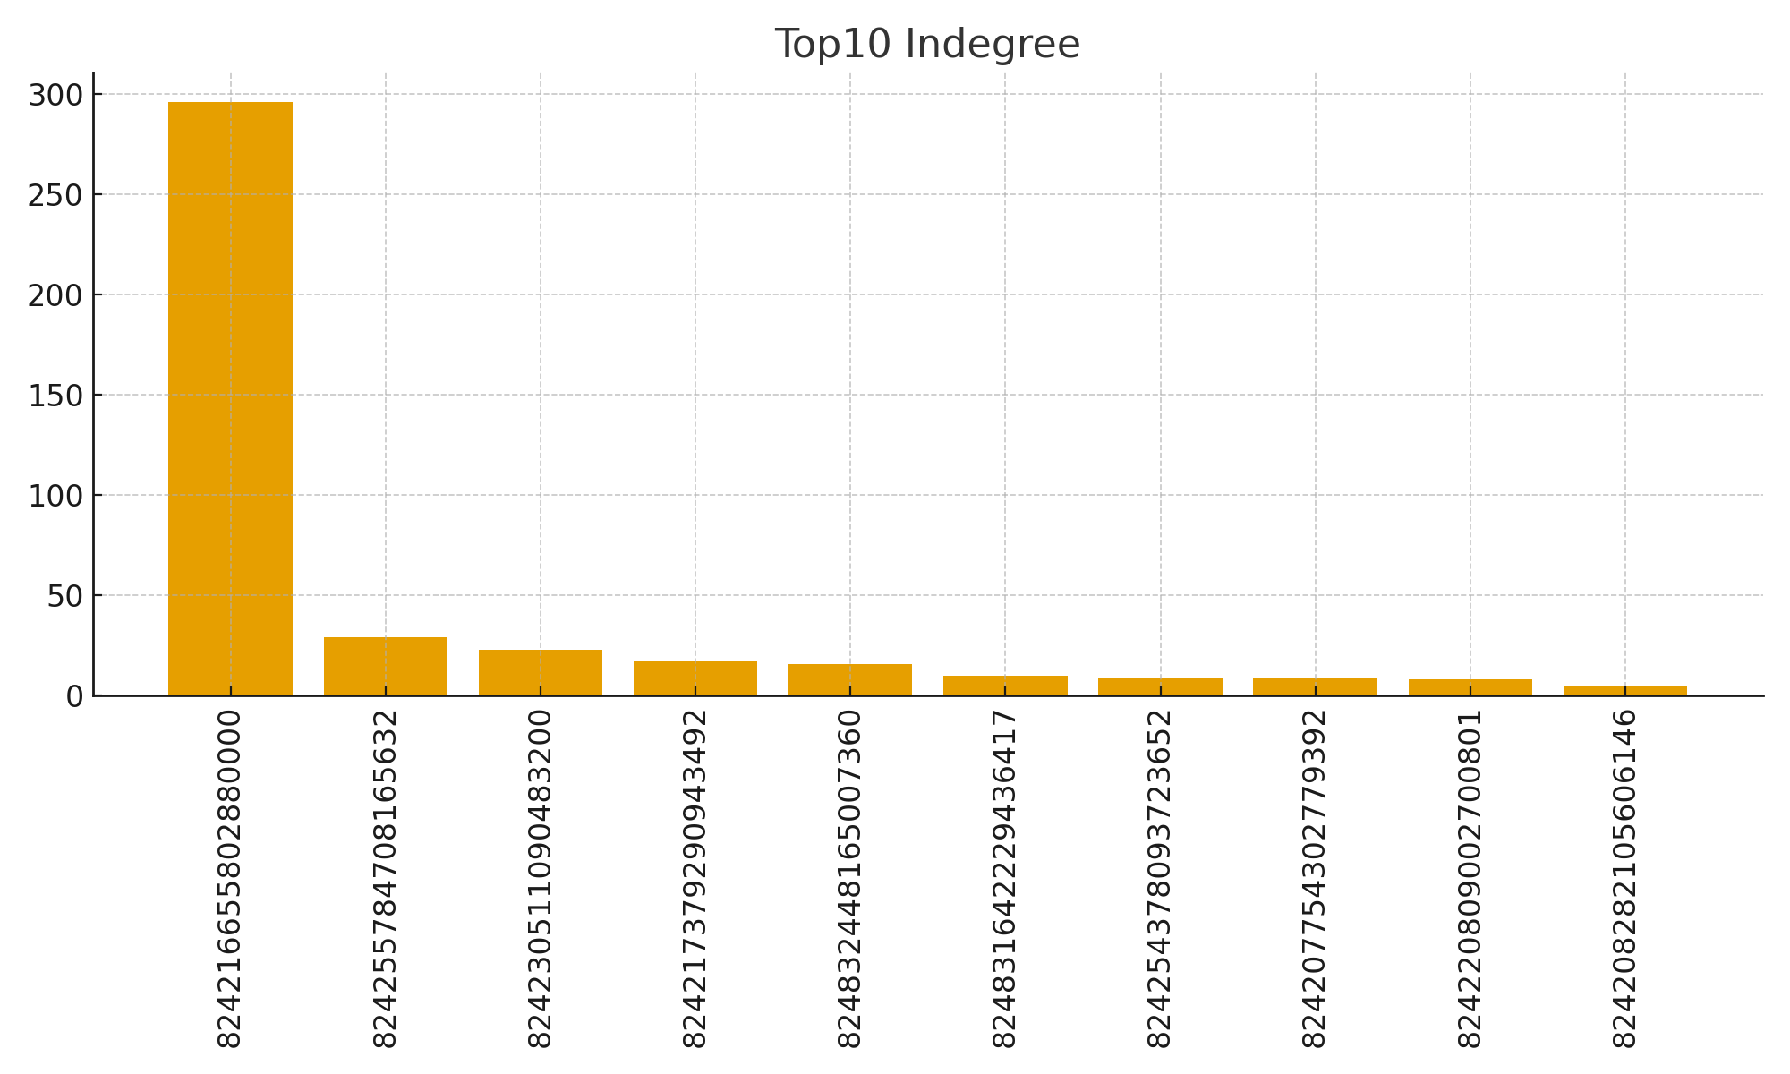
Top 10 Indegree
Shows users most retweeted. These are Xoxoday’s top influencers.
The chart 'Top 10 Influencers (Indegree)' shows key structural network insights:
• Helps identify how engagement flows
• Indicates influencers, connectors, or cluster hubs
• Supports strategic targeting and posting adjustments

Slide 9
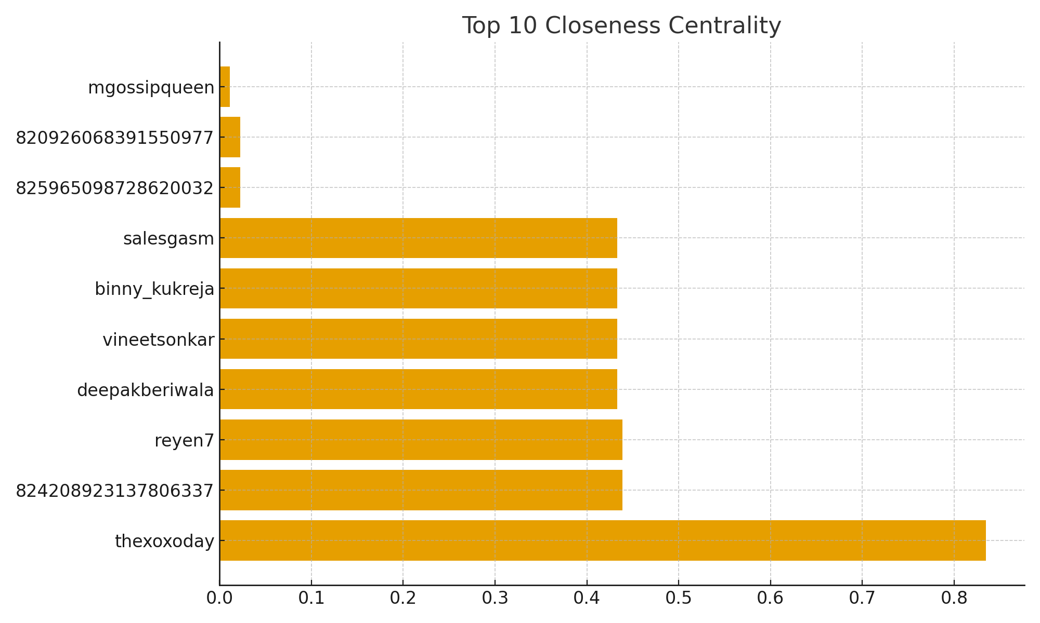
These users bridge multiple communities and are critical for spreading information across clusters. Partnering with them increases message reach.
The chart 'Closeness Distribution' shows key structural network insights:
• Helps identify how engagement flows
• Indicates influencers, connectors, or cluster hubs
• Supports strategic targeting and posting adjustments
TOP 10Closeness

Slide 10
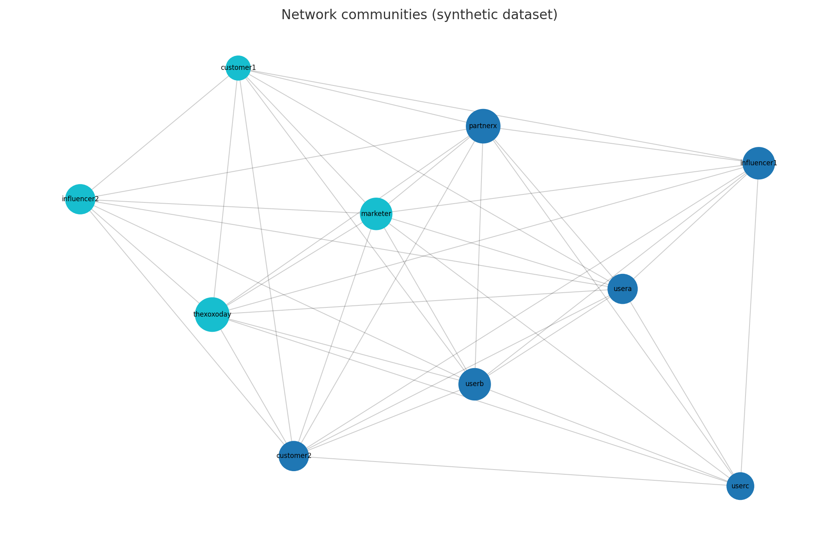
This infographic summarizes:
• Graph construction (directed edges)
• Cluster detection (modularity groups)
• Outcome (influencers & engagement structure)

Slide 11
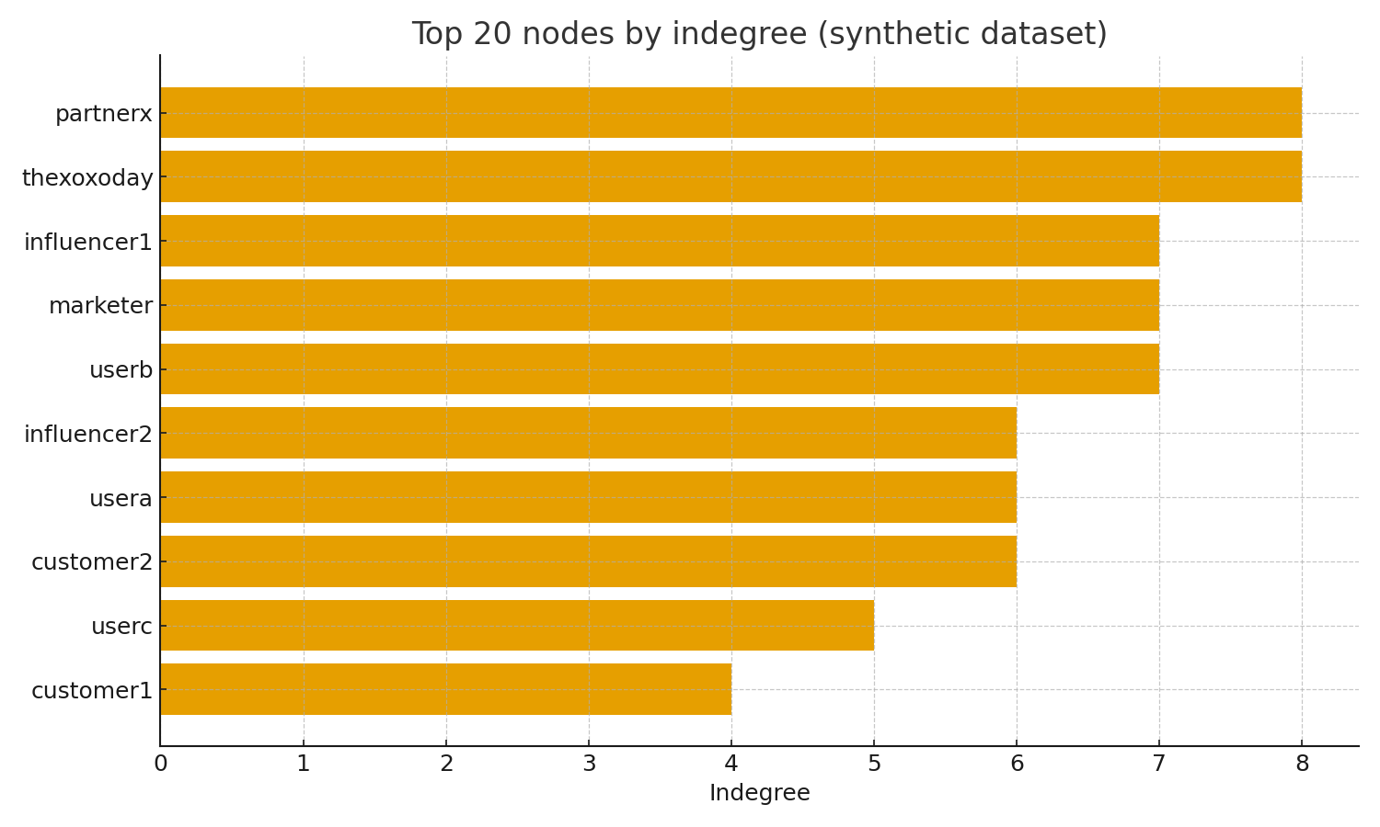

Slide 12
Recommendations
1. Partner with top influencers.
2. Increase visual and hashtag-based content.
3. Target identified communities.
4. Adjust posting schedule.
5. Create CTA-driven content.
6. Track SNA metrics weekly.
1. Partner with high indegree users (influencers).
2. Increase visual + hashtag content frequency.
3. Target content to 3 detected engagement clusters.
4. Post during peak engagement windows.
5. Use CTA-driven messaging & contest-based promotions.
6. Monitor SNA metrics monthly to measure improvement. Identify top influencers (target for partnerships)
Optimize posting schedule to match active clusters' time zones
Prioritize content formats that drove retweets/engagement
Run A/B tests with influencer-shared content • Leverage influencers (e.g., thexoxoday is central) for amplification.
• Create targeted content and track engagement via network metrics.
• Run A/B tests on post formats and measure retweet propagation.
• Monitor betweenness nodes for information flow control.

